Slide 1

Process Design of Ethylene Glycol
Advisor: Ardila Hayu Tiwikrama

Slide 2




Team
Cindy Suyitno B10806211
Leader
Jeane Anglica Yulianadi Susanto B10806212
Member
Philemon Sugiarta B10806203
Member

Slide 3

Outline
Introduction
Thermodynamic Model
Safety and Waste Management
Process Flowsheet Design
Economic Analysis
Conclusion

Slide 4

Introduction review

Slide 5
Introduction & Marketing
Introduction
Ethylene glycol (CH₂OH)₂ is an odorless, colorless, sweet-tasting, viscous liquid that can be produce in many ways, however, we use CO as our main compound to produce ethylene glycol
Application
Coolant and Heat Transfer Agent
Antifreeze
Precursor to Polymer
Dehydrating Agent
Hydrate Inhibition
Market Demand & Price
Data shows that from 2021 to 2026 the market of ethylene glycol will increase for 3.2%
It will reach from USD 20930 million in 2021 to USD 25290 million by 2026.
4% growth on CAGR, and 3.50% year-over-year growth rate for 2019

Slide 6
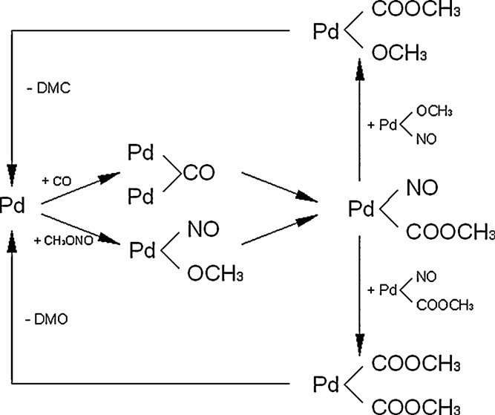
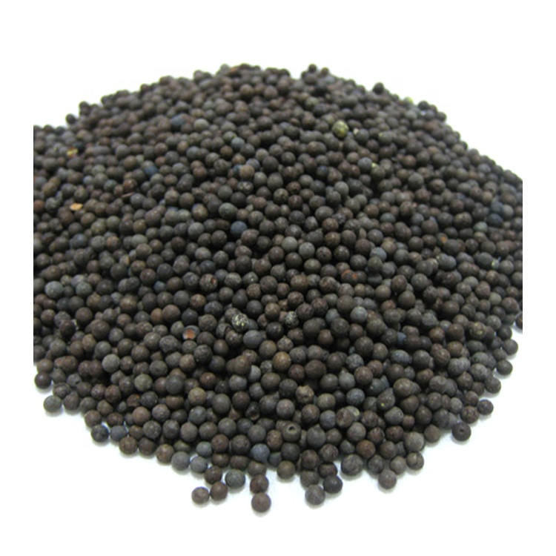
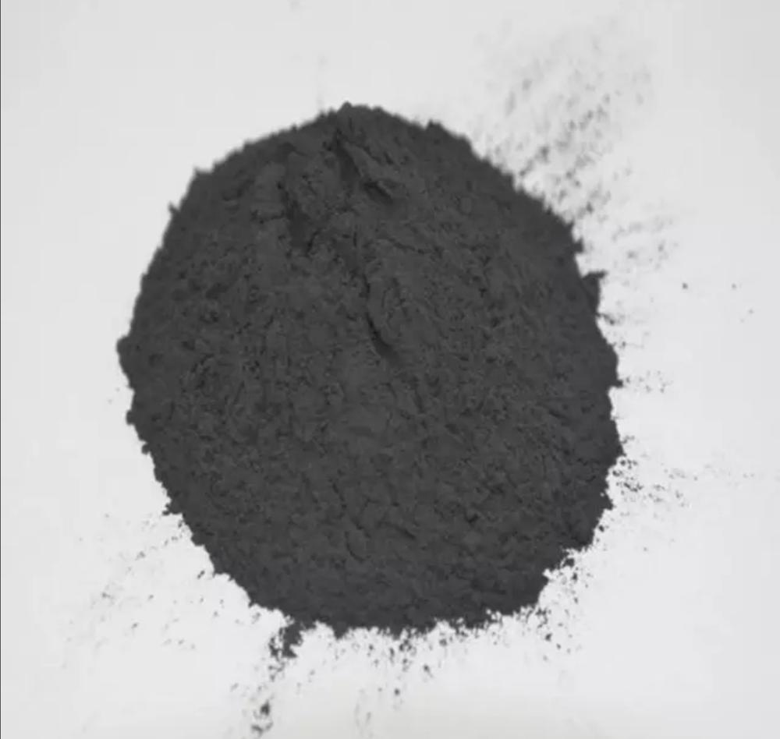
Catalyst Used → Pd/Al₂O₃ and Cu/SiO₂
For Pd/Al₂O₃
Recycling Pd/Al₂O₃ needs treatment (NaCl, HCl, FeCl₃)
Have a lifetime of 8000 h.
Adsorption of reactants initiates the coupling reaction
Pd and alumina has excellent surface condition

Slide 7
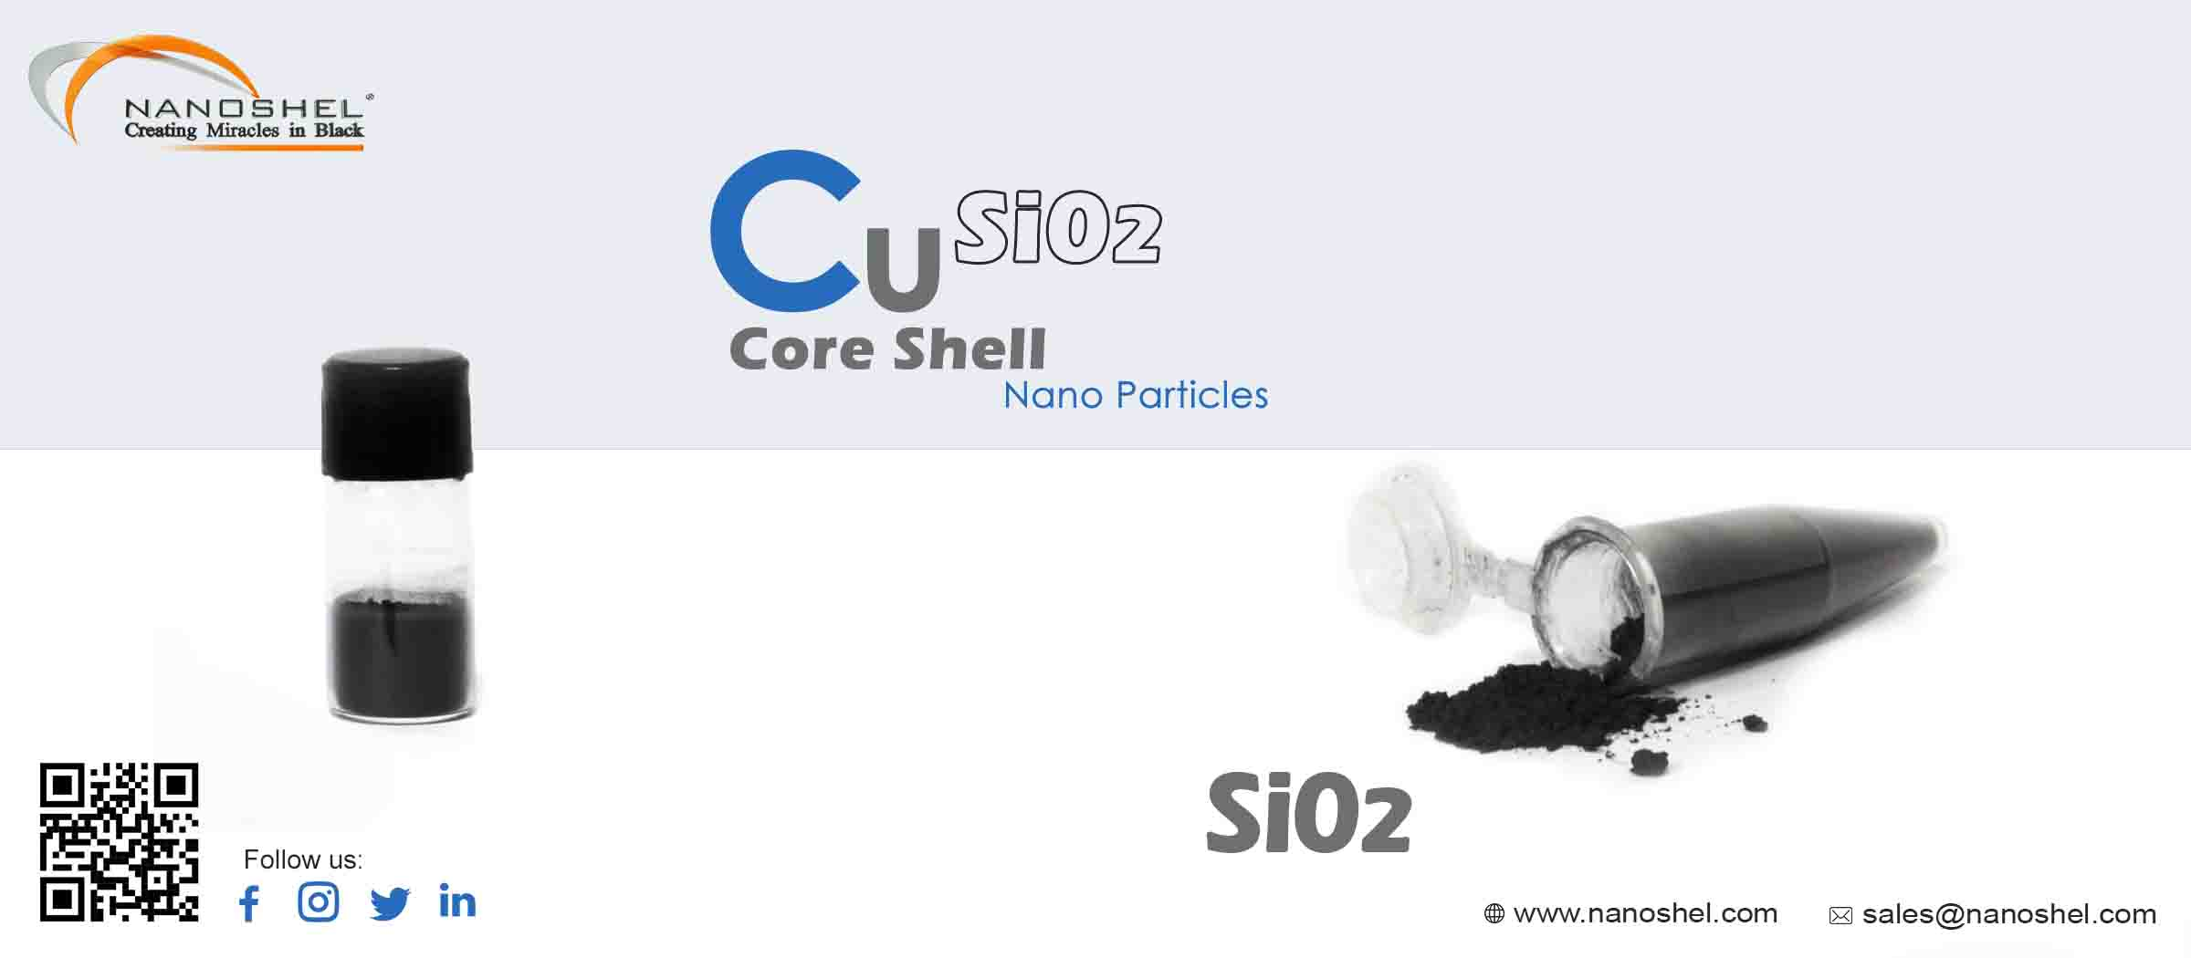
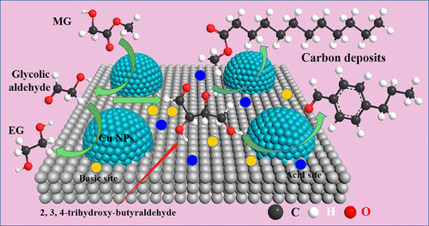
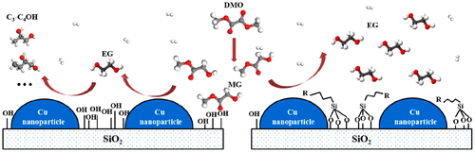
Catalyst Used → Pd/Al₂O₃ and Cu/SiO₂
For Cu/SiO₂
Recycling in Refluxing Ethanol
Cu/SiO₂ catalyst showed 99.9% conversion with 94% EG selectivity and a lifetime of over 3080 h
Surface modification improves stability
Reduced C3-C4OH selectivity and enhanced catalytic stability

Slide 8
Catalyst regeneration → Pd/Al₂O₃ and Cu/SiO₂
For Pd/Al₂O₃
Palladium can relatively simply be dissolved in hydrochloric solution with an appropriate oxidant present under a suitable conditions.
Roasting as a pretreatment → 600°C for 2h
Palladium leaching w/ HCl + Oxidant
Oxidants (i.e. H₂O₂, NaClO₃, NaClO₃) → different temperature yields different results
Reducing step w/ reduction agent (i.e. HCOOH, HCOOH+HCl, N₂H₄.H₂O) → increase yield ratio
Example:
i.e. 6M HCl and 2.0g/L NaClO₃ at 95°C for 1h
For Cu/SiO₂
Based on literature: Cu/SiO₂ can be reused for 5 times
We will change our catalyst after 3 cycles

Slide 9
Catalyst regeneration → Pd/Al₂O₃
Oxidants conc. Used:
Roasting Temperature (°C) | Types of oxidant | Conc. Of oxidant (mol/L) | Palladium extraction
575 | H₂O₂ | 1.5 | 97.09
575 | NaClO₃ | 2.5* | 98.71
600 | H₂O₂ | 1.5 | 91.70
600 | NaClO₃ | 2.5* | 93.52
→
Reduction agents conc. Used:
Types | None | HCOOH | HCOOH+HCl | N₂H₄’H₂O
Ratio / % | 53.12 | 91.04 | 85.62 | 91.10
→

Slide 10
Reference
Anyuan Yin, X. G.-L. (2009). The Nature of Active Copper Species in Cu-HMS Catalyst for Hydrogenation of Dimethyl Oxalate to Ethylene Glycol: New Insights on the Synergetic Effect between Cu0 and Cu+. Journal Physical Chemistry, 113, 11003–11013.
Charlie Paris, A. K. (2020). CO2 Hydrogenation to Methanol with Ga- and Zn-Doped Mesoporous Cu/SiO2 Catalysts Prepared by the Aerosol-Assisted Sol-Gel Process. ChemSusChem, 13 (23), 6409-6417.
Deboshree Mukherjee, †. R. (n.d.).
Deboshree Mukherjee, R. S. (2019). Ceria Promoted Cu-Ni/SiO2 Catalyst for Selective Hydrodeoxygenation of Vanillin. ACS Omega, 4 (3), 4770-4778.
Helena D. de Salles, T. L. (2019). Imidazo[1,2-a]pyridine A3-Coupling Catalyzed by a Cu/SiO2 Material. JBCS30, 9 (30), 1825-1833.
Jai Young Chung, S. K. (2019). Preparation of a Pd/Al2O3 Catalyst with Microwave-Induced Plasma Jet Irradiation under Atmospheric Pressure. Nanomaterials, 9(12), 1734.
Jai Young Chung, S. K. (2019). Preparation of a Pd/Al2O3 Catalyst with Microwave-Induced Plasma Jet Irradiation under Atmospheric Pressure. Nanomaterials, 9(12), 1734.
José M. Fraile, K. L. (2013). CuO/SiO2 as a simple, effective and recoverable catalyst for alkylation of indole derivatives with diazo compounds. Organic & Biomolecular Chemistry, 11, 4327.
Katarina Persson, L. D. (2007). Stability of palladium-based catalysts during catalytic combustion of methane: The influence of water. Applied Catalysis B: Environmental, 242–250.
Leonid M. Kustov, A. L. (2021). Enhancement of Efficiency of Pd/Al2O3Catalysts in Selective Hydrogenation of Sec-Butylbenzene by Modification with H2SO4 or H2WO4. Metals, 11(2), 281.
Meilin Wang, D. Y. (2020). Enhanced Selectivity and Stability of Cu/SiO2 Catalysts for Dimethyl Oxalate Hydrogenation to Ethylene Glycol by Using Silane Coupling Agents for Surface Modification. Industrial & Engineering Chemistry Research , 59 (20), 9414-9422.
Qinghe Zheng, R. F. (2015). Part II: Oxidative Thermal Aging of Pd/Al2O3 and Pd/CexOy-ZrO2 in Automotive Three Way Catalysts: The Effects of Fuel Shutoff and Attempted Fuel Rich Regeneration. Catalysts, 5(4), 1797-1814.
Shanhui Zhu, *. X. (2015). A highly efficient and robust Cu/SiO2 catalyst prepared by the ammonia evaporation hydrothermal method for glycerol hydrogenolysis to 1,2-propanediol†. Catalysis Science & Technology, 5, 1169-1180.
Yongbin Yang, L. H. (2016). RECOVERY OF PALLADIUM FROM SPENT Pd/Al2O3 CATALYST BY HYDROCHLORIC ACID LEACHING. Characterization of Minerals, Metals, and Materials, 311-318.
Yujun Zhao, L. K. (2020). Deactivation Mechanism of Cu/SiO2 Catalysts in the Synthesis of Ethylene Glycol via Methyl Glycolate Hydrogenation. Industrial & Engineering Chemistry Research, 59 (27), 12381-12388.
Yunji Ding, H. Z. (2019). An Efficient Leaching of Palladium from Spent Catalysts through Oxidation with Fe(III). Materials, 12(8), 1205.

Slide 11
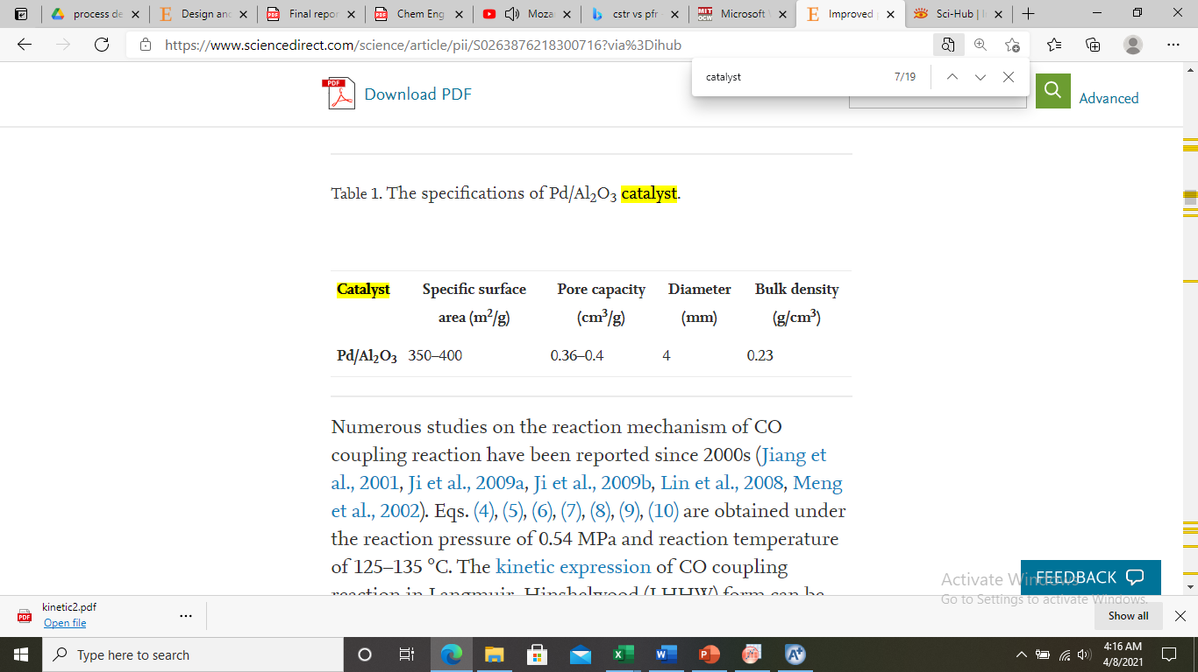
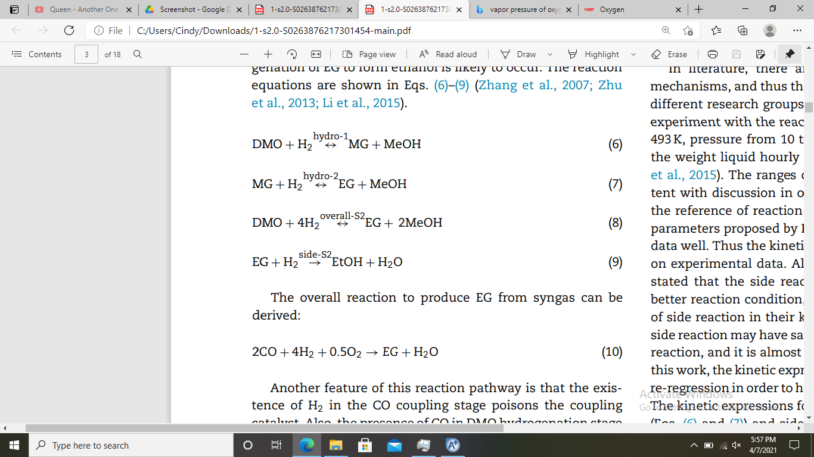
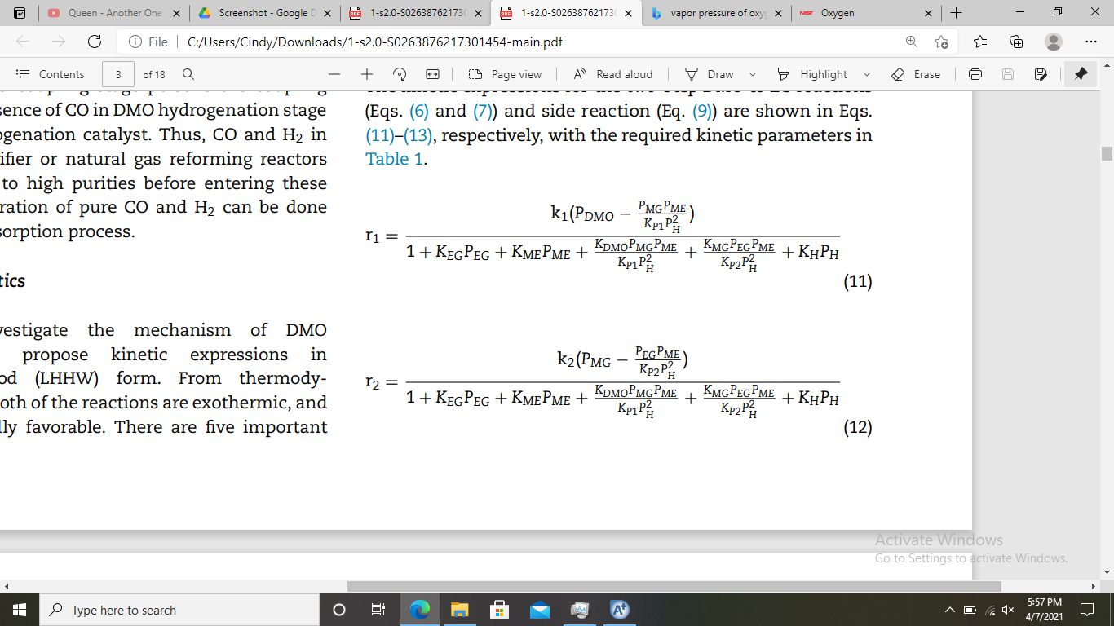
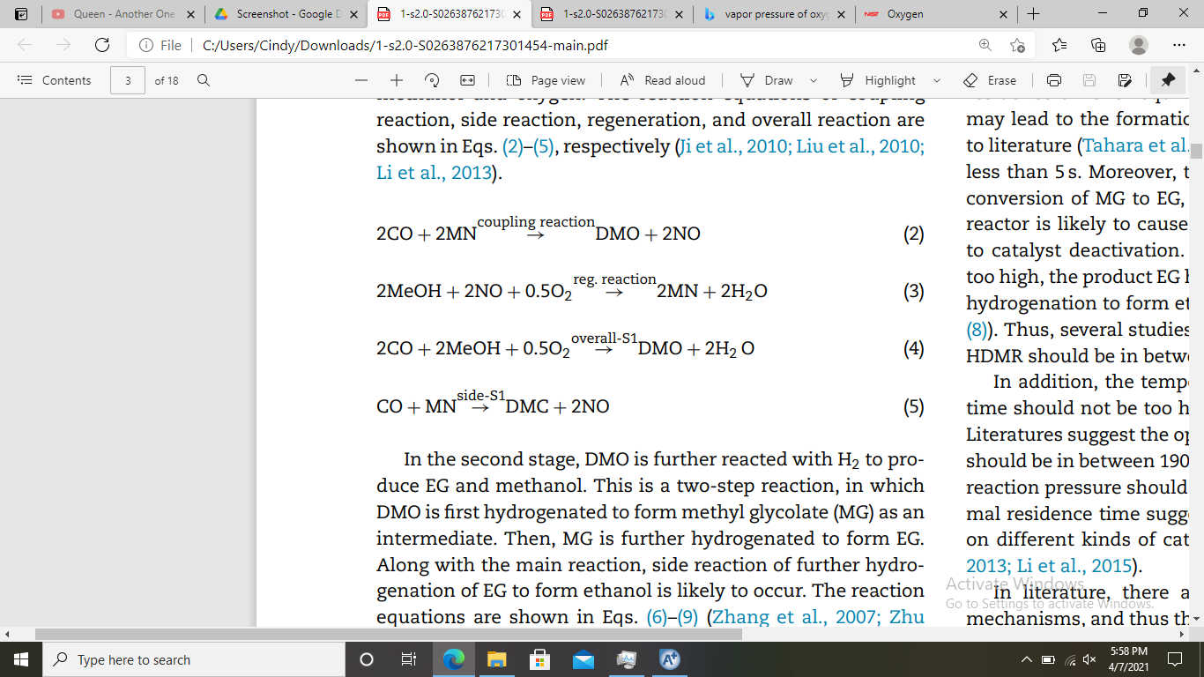
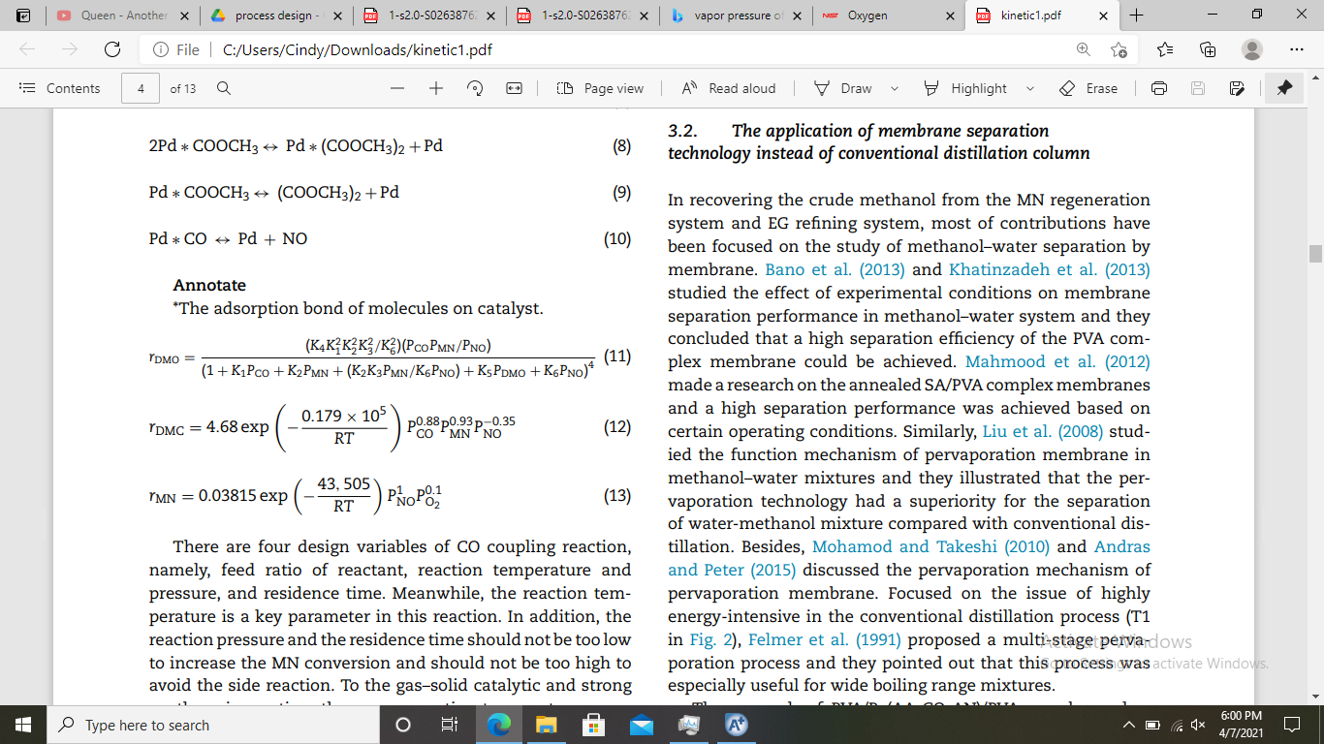
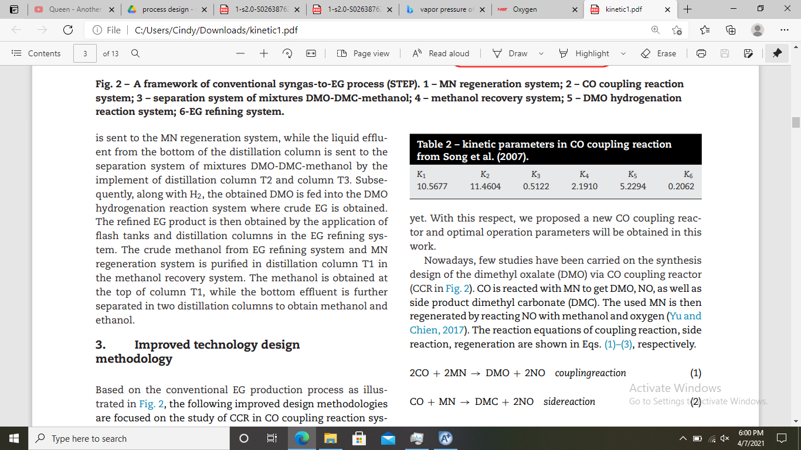
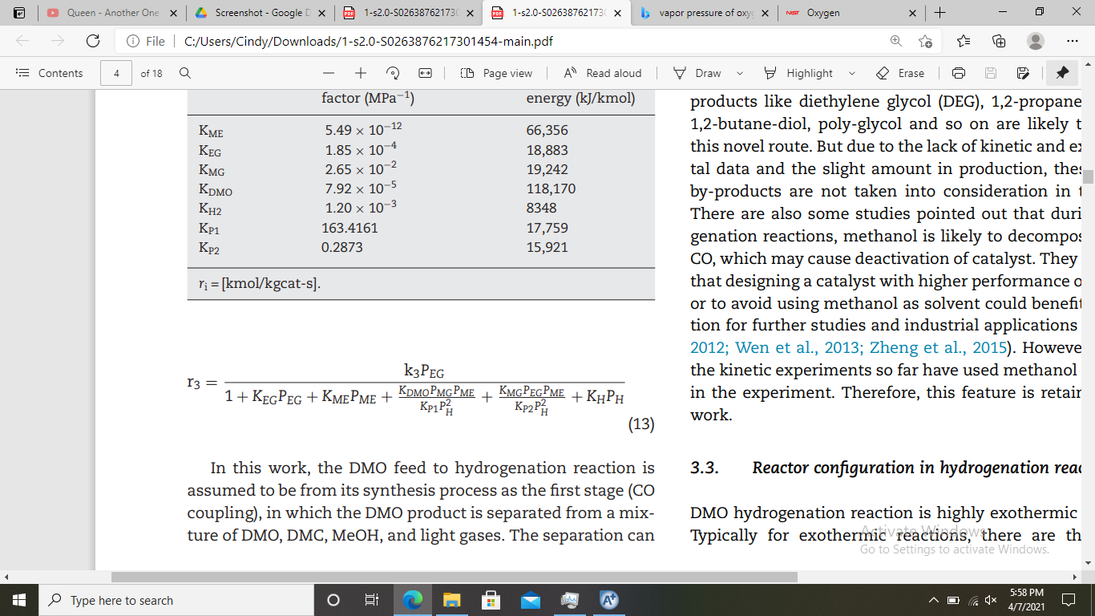
REACTIONS
Catalyst: Pd/Al₂O₃
Catalyst: Cu/SiO₂; spec: ρ = 980 kg/m³, ε = 0.5
3. Hydrolysis 1
1. Coupling Reaction
4. Hydrolysis 2
2. Side Reaction 1
5. Side Reaction 2
Wei, Renxing; Yan, Chenglei; Yang, Ao; Shen, Weifeng; Li, Jie (2018). Improved process design and optimization of 200 kt/a ethylene glycol production using coal-based syngas. Chemical Engineering Research and Design, (), S0263876218300716–. doi:10.1016/j.cherd.2018.02.006
Yu, Bor-Yih; Chien, I-Lung (2017). Design and optimization of dimethyl oxalate (DMO) hydrogenation process to produce ethylene glycol (EG). Chemical Engineering Research and Design, 121(), 173-190. doi:10.1016/j.cherd.2017.03.012

Slide 12
Thermodynamic Model
NRTL-RK (Non-Random Two Liquid-Redlich Kwong)
RK EOS: more accurate than ideal gas and Van der Waals equation at temperatures above critical points.
NRTL: suitable for non-polar component, non-ideal system, can be used for VLE, LLE, VLLE system (flexible)
Our main paper references use this model

Slide 13

Thermodynamic Model

Slide 14
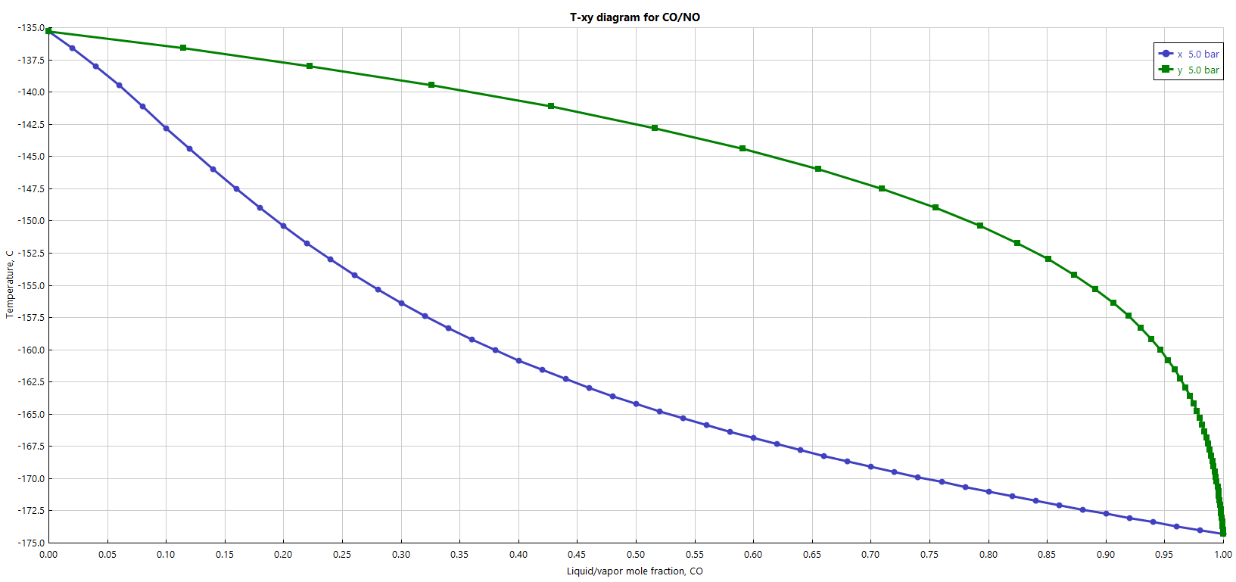
TXY Diagram
First separation: CO from NO-DMO
Reflux temperature
CO-NO; P= 5 bar

Slide 15
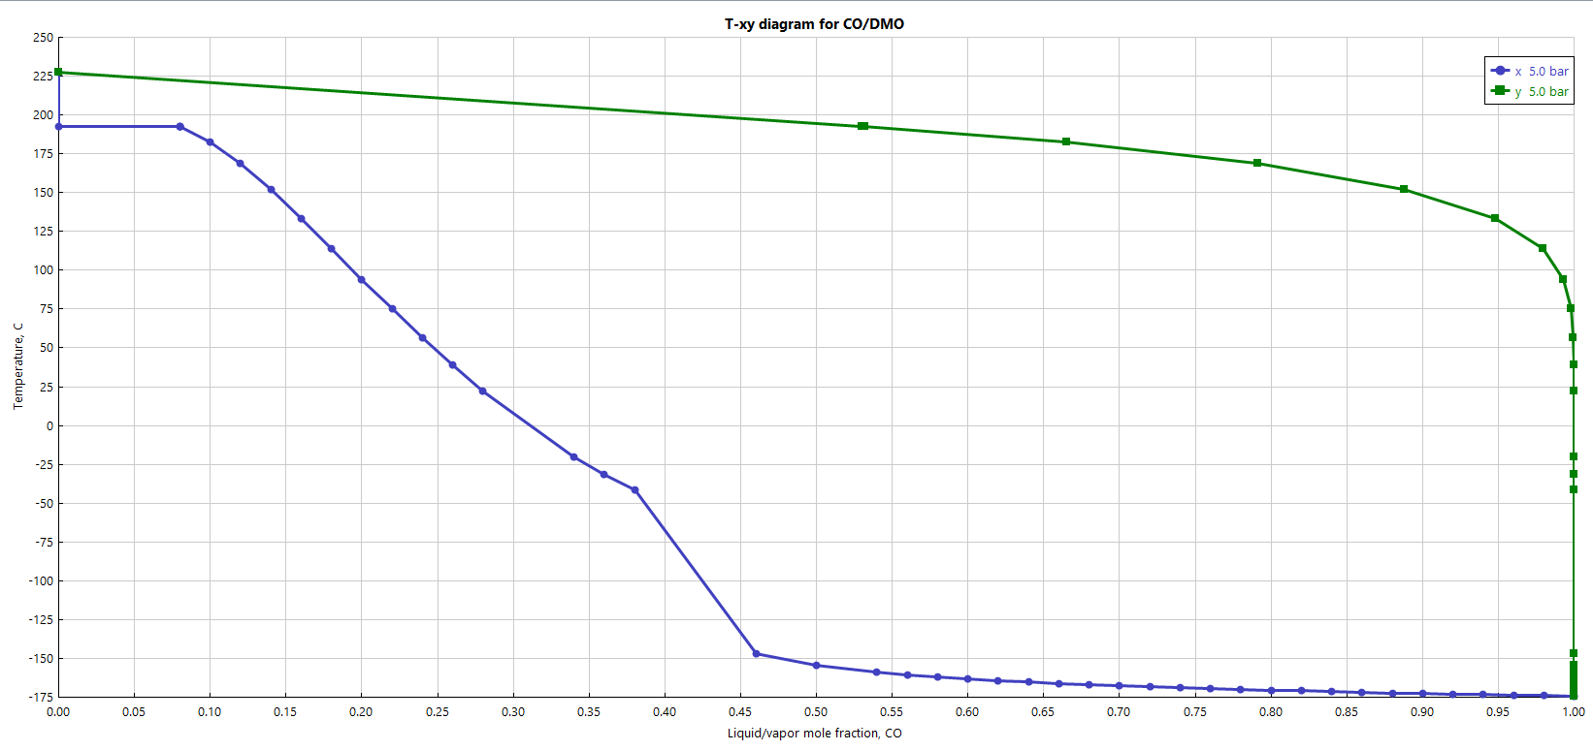
TXY Diagram
First separation: CO from NO-DMO
Feed temperature
Reflux temperature
CO-DMO; P= 5 bar

Slide 16
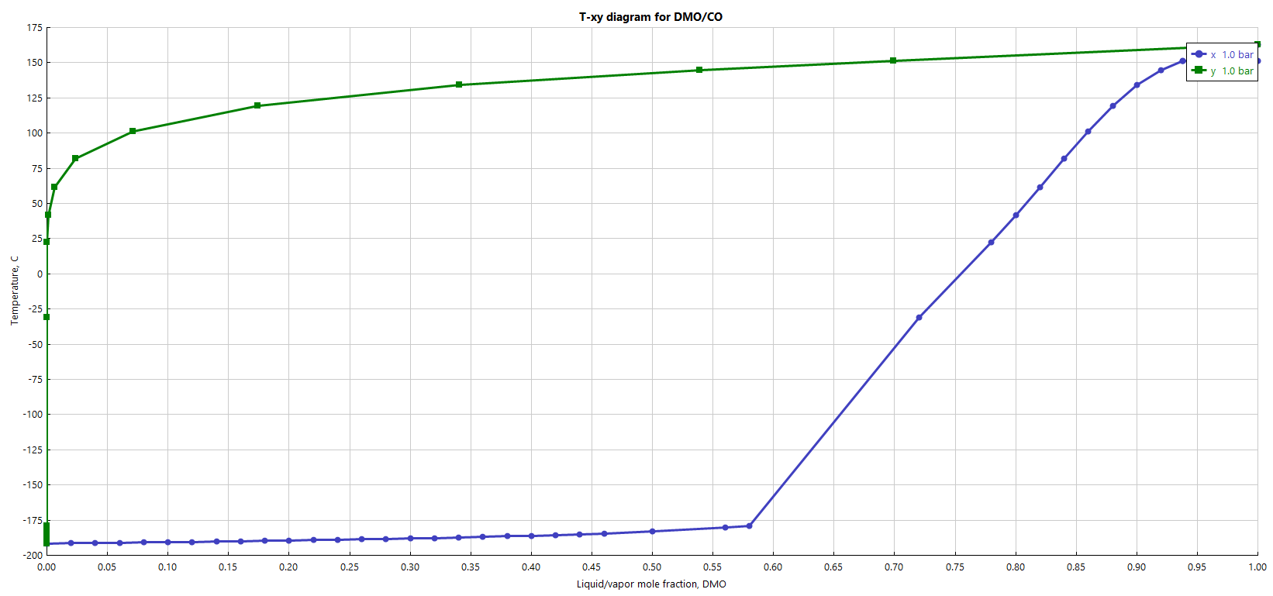
TXY Diagram
Second separation: DMO from CO-NO
Bottom product
Flash tank
Feed temperature
Distillate product
DMO-CO; P= 1 bar

Slide 17
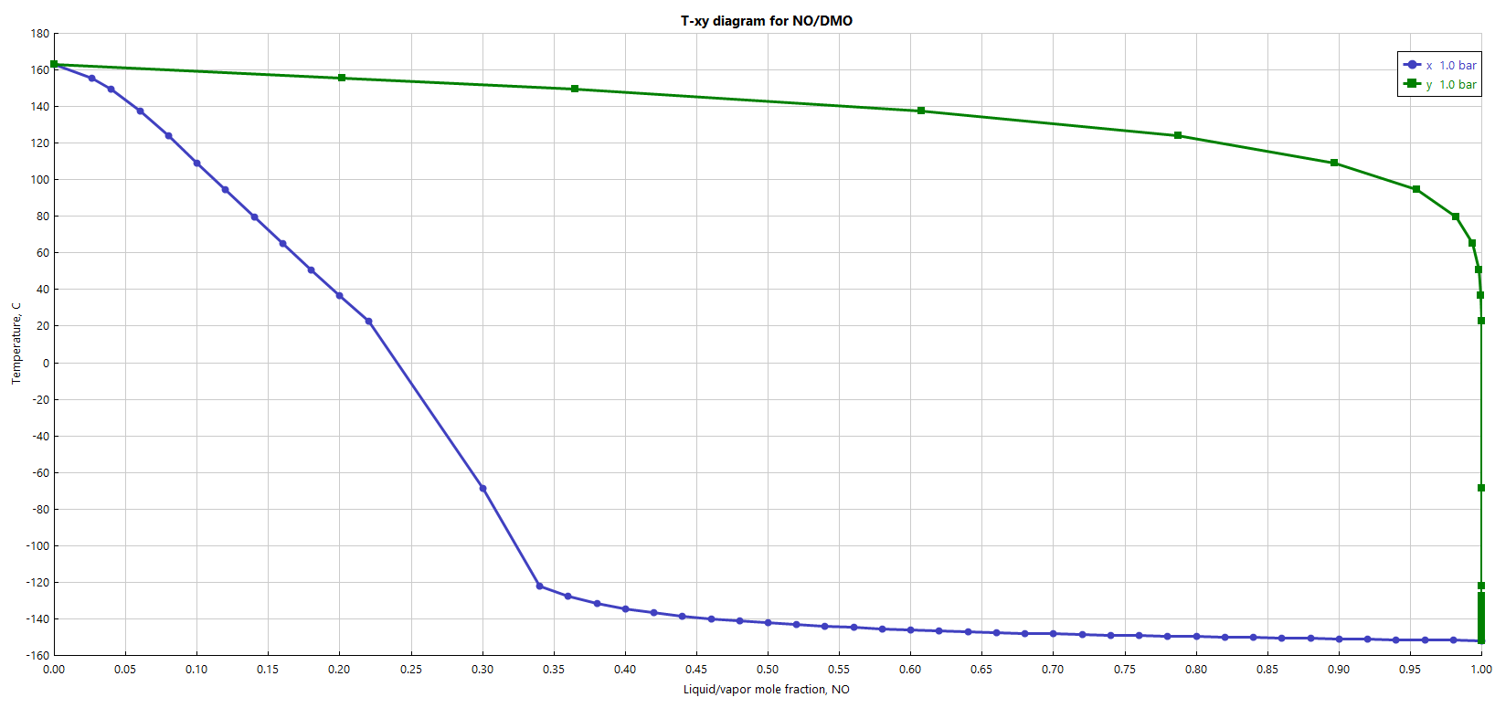
TXY Diagram
Second separation: DMO from CO-NO
Bottom product
Flash tank
Feed temperature
NO-DMO; P= 1 bar

Slide 18
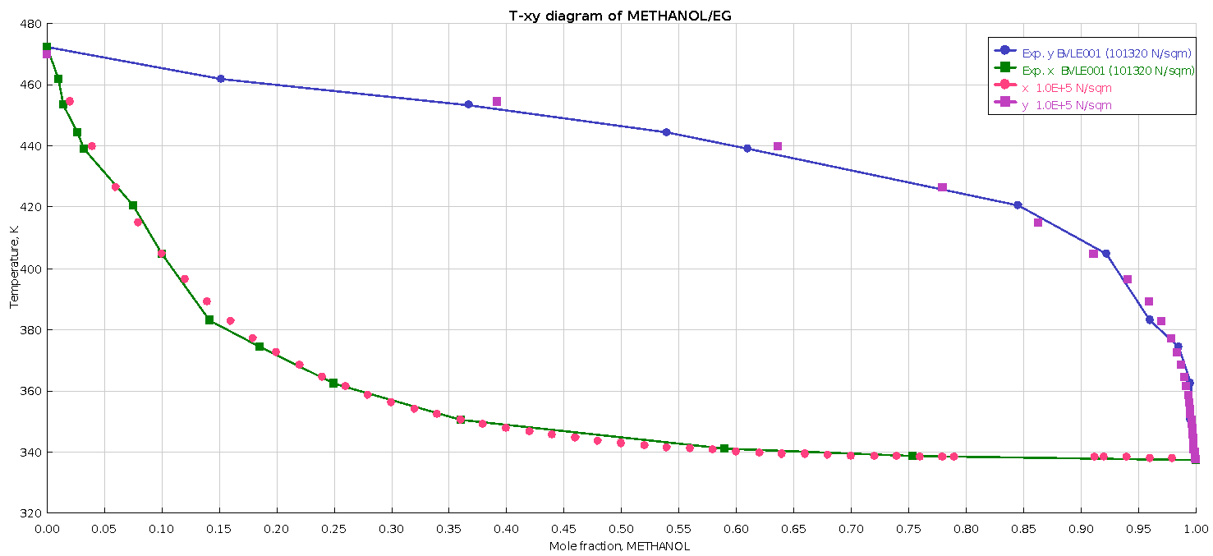
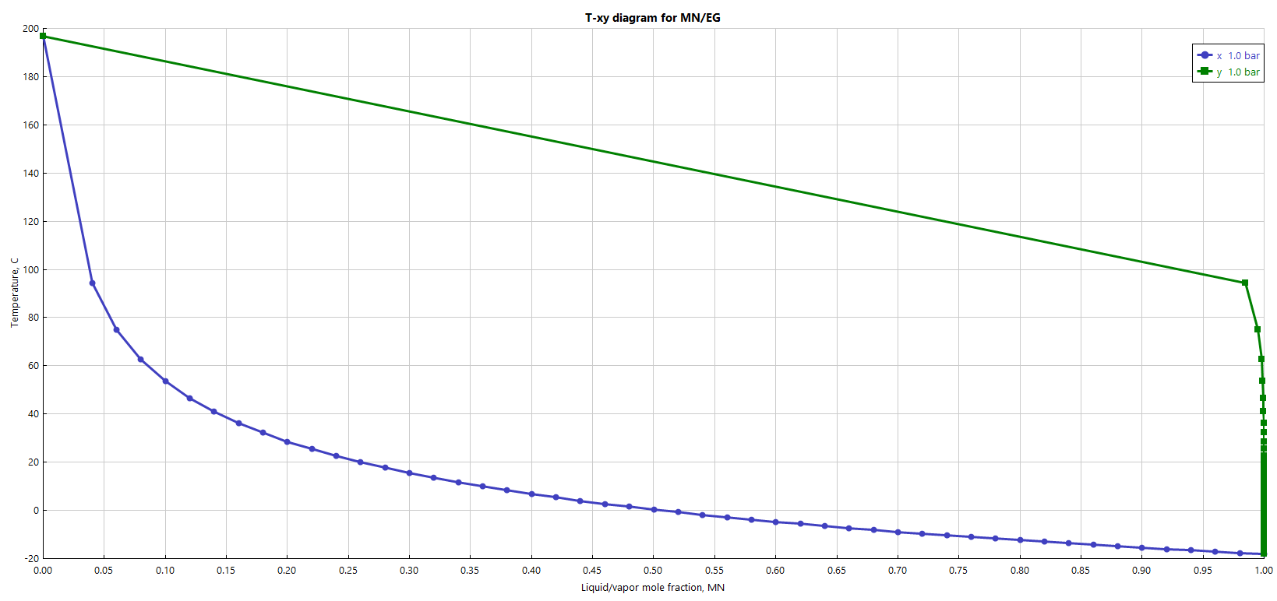
TXY Diagram
Third separation: EG from DMO-H2-MeOH-Mg-NO-MN
Bottom product 1st flowsheet
Distillate product 1st flowsheet
Bottom product 2nd flowsheet
Distillate product 2nd flowsheet
METHANOL-EG; P= 1 bar
MG-EG; P= 1 bar
MN-EG; P= 1 bar

Slide 19
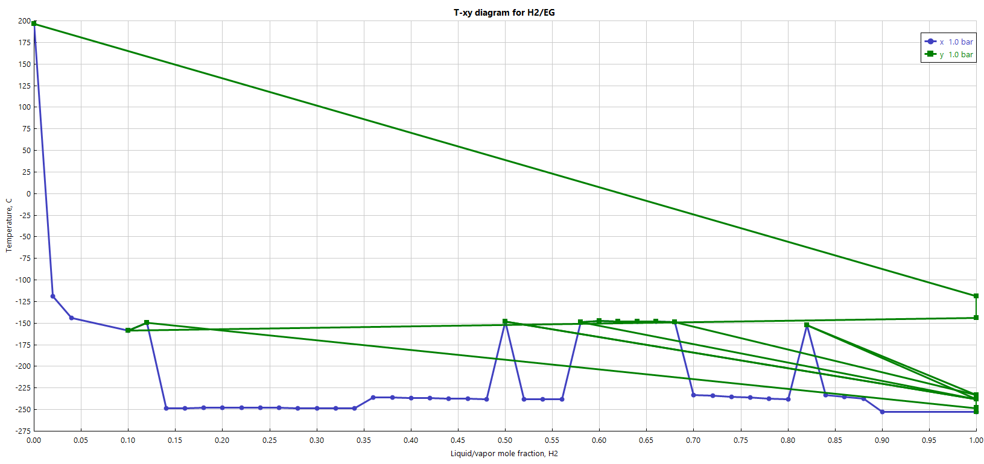
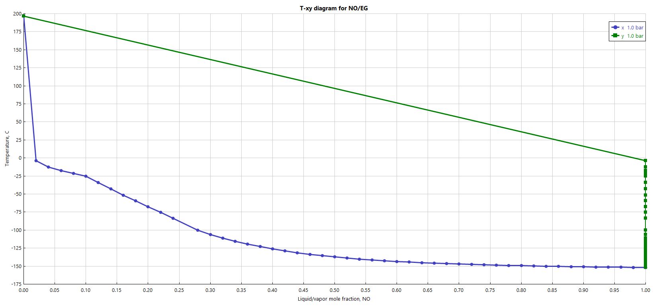
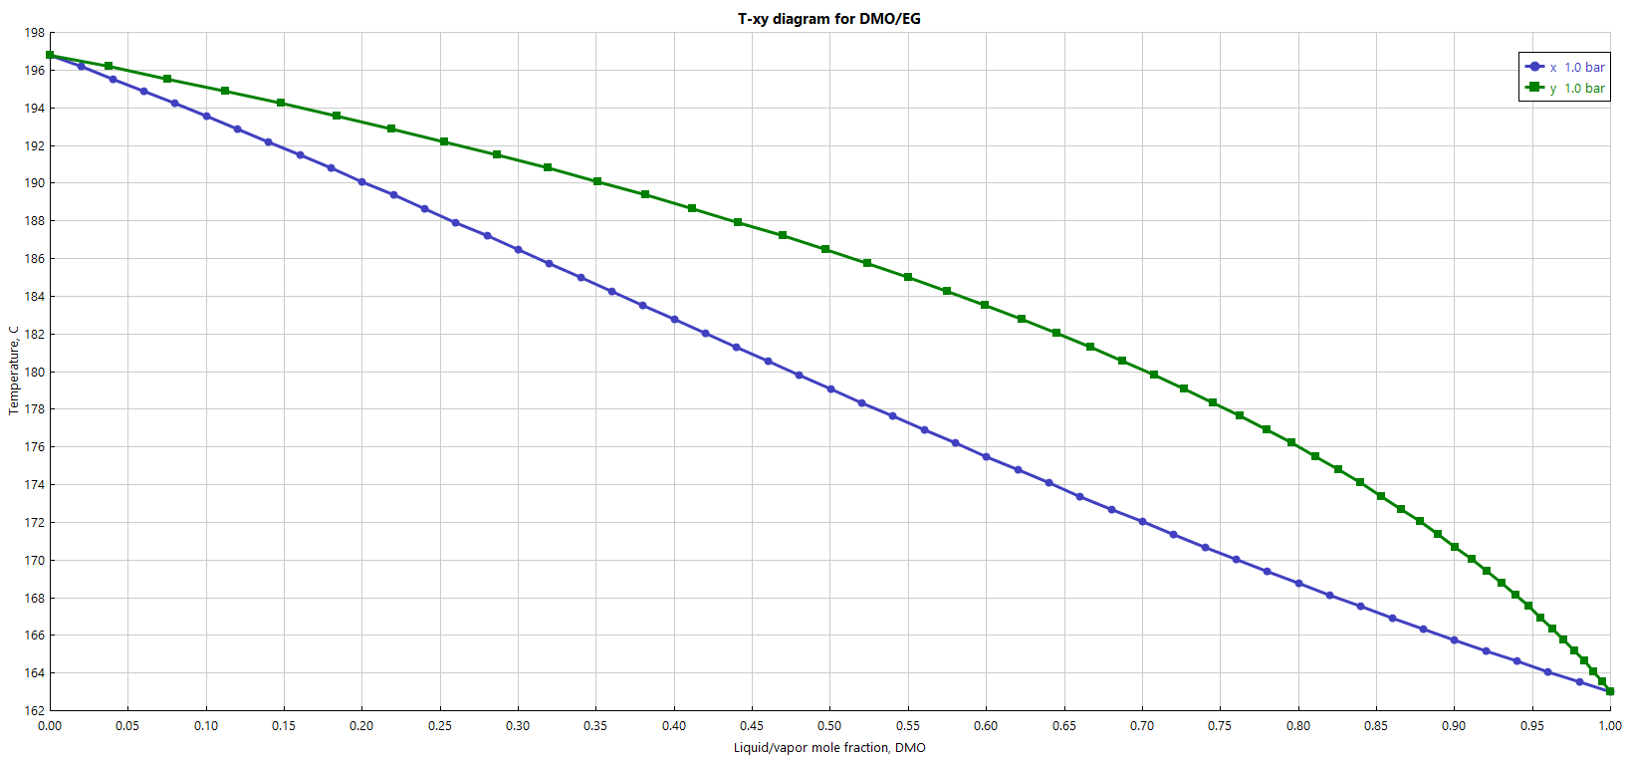
TXY Diagram
Third separation: EG from DMO-H2-MeOH-Mg-NO-MN
Bottom product 1st flowsheet
Distillate product 1st flowsheet
Bottom product 2nd flowsheet
Distillate product 2nd flowsheet
H2-EG; P= 1 bar
NO-EG; P= 1 bar
DMO-EG; P= 1 bar

Slide 20
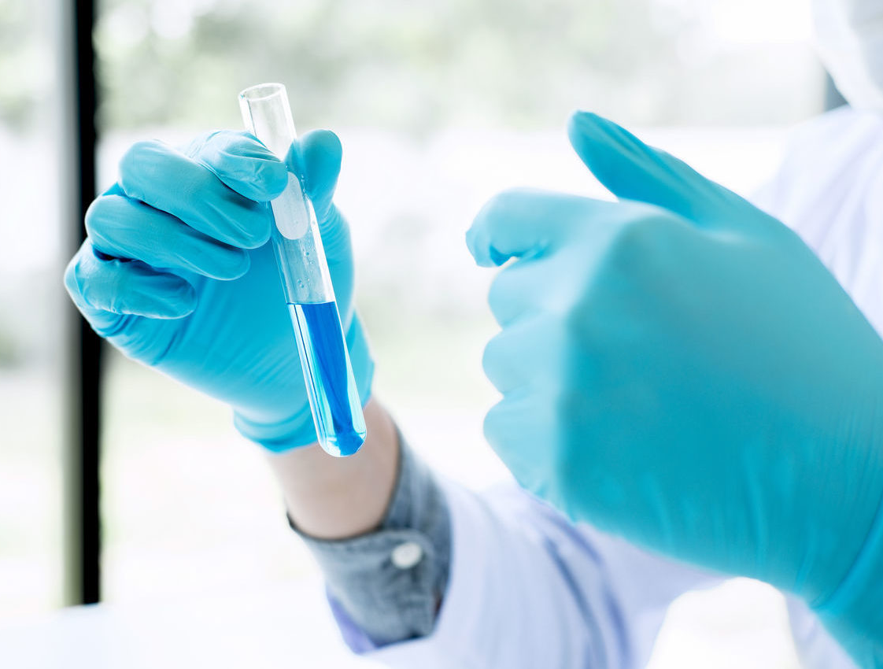
Safety Management

Slide 21
Carbon Monoxide
Danger
Protection
Extremely flammable gas, toxic if inhaled
Causes damage to organs (central nervous system) through prolonged or repeated exposure
May form explosive mixtures with air
Asphyxiating even with adequate oxygen.
Keep away from heat, hot surfaces, sparks, open flames and other ignition sources, no smoking.
Use only explosion-proof equipment.
Use in a closed system.
Do not breathe gas.

Slide 22
Dimethyl Carbonate
Danger
Protection
Hazardous in case of skin contact (irritant), of eye contact (irritant). Slightly hazardous in case of skin contact (permeator), of
ingestion, of inhalation.
Provide exhaust ventilation or other engineering controls to keep the airborne concentrations of vapors below their respective threshold limit value.
Ensure that eyewash stations and safety showers are proximal to the work-station location.

Slide 23
Dimethyl oxalate
Danger
Protection
May be harmful if inhaled. Causes respiratory tract irritation.
May be harmful if absorbed through skin.
Causes skin irritation.
Causes eye irritation.
May be harmful if swallowed.
Wash skin thoroughly after handling.
Wear protective gloves/ eye protection/ face protection.
IF ON SKIN: Wash with plenty of soap and water.
IF IN EYES: Rinse cautiously with water for several minutes. Remove contact lenses, if present and easy to do. Continue rinsing.

Slide 24
Ethanol
Danger
Protection
Flammable liquid and vapor
Causes skin irritation
Causes serious eye irritation
May cause cancer (Ingestion)
Suspected of damaging the unborn child (Ingestion
Causes damage to organs (central nervous system, optic nerve) (oral, Dermal)
Keep away from heat, hot surfaces, open flames, sparks.
No smoking
Keep container tightly closed
Ground/bond container and receiving equipment
Use explosion-proof electrical, lighting, ventilating equipment

Slide 25
Ethylene Glycol
Danger
Protection
Harmful if swallowed
May cause damage to organs (kidney) through prolonged or repeated exposure (if swallowed)
Do not breathe mist/vapours.
Do not eat, drink or smoke when using this product.
IF SWALLOWED: Call a POISON CENTER or doctor if you feel unwell.

Slide 26
Hydrogen
Danger
Protection
Extremely flammable gas
Contains gas under pressure; may explode if heated
May displace oxygen and cause rapid suffocation.
May form explosive mixtures with air
Burns with invisible flame.
Keep away from Heat, Open flames, Sparks, Hot surfaces.
No smoking
Use and store only outdoors or in a well-ventilated place.
Eliminate all ignition sources if safe to do so
Use a back flow preventive device in the piping.

Slide 27
Methanol
Danger
Protection
Highly flammable liquid and vapor
Toxic if swallowed, in contact with skin or if inhaled
Causes damage to organs (liver, kidneys, central nervous system, optic nerve) (Dermal, oral)
Keep away from heat, sparks, open flames, hot surfaces.
No smoking.
Use explosion-proof electrical, ventilating, lighting equipment.
Take precautionary measures against static discharge.
Do not breathe mist, vapors, spray.

Slide 28
Methyl glycolate
Danger
Protection
Irritating to eyes and skin on contact. Inhalation causes irritation of the lungs and respiratory system. Inflammation of the
eye is characterized by redness, watering, and itching. Skin inflammation is characterized by itching, scaling, reddening, or,
occasionally, blistering. Follow safe industrial hygiene practices and always wear proper protective equipment when handling this compound.
Keep away from heat/sparks/open flames/hot surfaces. - No smoking
Wear protective gloves/protective clothing/eye protection/face protection

Slide 29
Methyl nitrite
Protection
Ensure that medical personnel are aware of the material(s) involved and take precautions to protect themselves. Move victim to fresh air. Call 911 or emergency medical service. Give artificial respiration if victim is not breathing. Administer oxygen if breathing is difficult. Remove and isolate contaminated clothing and shoes. In case of contact with liquefied gas, thaw frosted parts with lukewarm water. In case of burns, immediately cool affected skin for as long as possible with cold water. Do not remove clothing if adhering to skin. Keep victim calm and warm.
Danger
Vapors may cause dizziness or asphyxiation without warning.
Some may be toxic if inhaled at high concentrations.
Contact with gas or liquefied gas may cause burns, severe injury and/or frostbite.
Fire may produce irritating and/or toxic gases.

Slide 30
Nitric Oxide
Danger
Protection
May cause or intensify fire; oxidizer
Contains gas under pressure; may explode if heated
Causes severe skin burns and eye damage
Fatal if inhaled
Corrosive to the respiratory tract
Symptoms may be delayed
Do not breathe gas
Do not get in eyes, on skin, or on clothing.
Wear protective gloves, protective clothing, eye protection, respiratory protection, and/or face protection.

Slide 31
Nitrogen
Protection
Danger
Use and store only outdoors or in a well-ventilated place.
Use a back flow preventive device in the piping.
Use only with equipment rated for cylinder pressure.
Close valve after each use and when empty.
Protect from sunlight when ambient temperature exceeds 52°C
Contains gas under pressure; may explode if heated
May displace oxygen and cause rapid suffocation

Slide 32
Oxygen
Danger
Protection
May cause or intensify fire; oxidizer
Contains gas under pressure; may explode if heated
Keep reduction valves/valves and fittings free from oil and grease
Use and store only outdoors or in a well-ventilated place.
IN CASE OF FIRE: Stop leak if safe to do so
Use a back flow preventive device in the piping.

Slide 33
Water
Uhh… it’s safe…?

Slide 34

Waste Management
Waste
Waste
Waste
Waste
Waste
Waste
Waste
Waste
Waste

Slide 35
Our Major Vapor Pollutants
Methanol
DMO
NO
MG

Slide 36
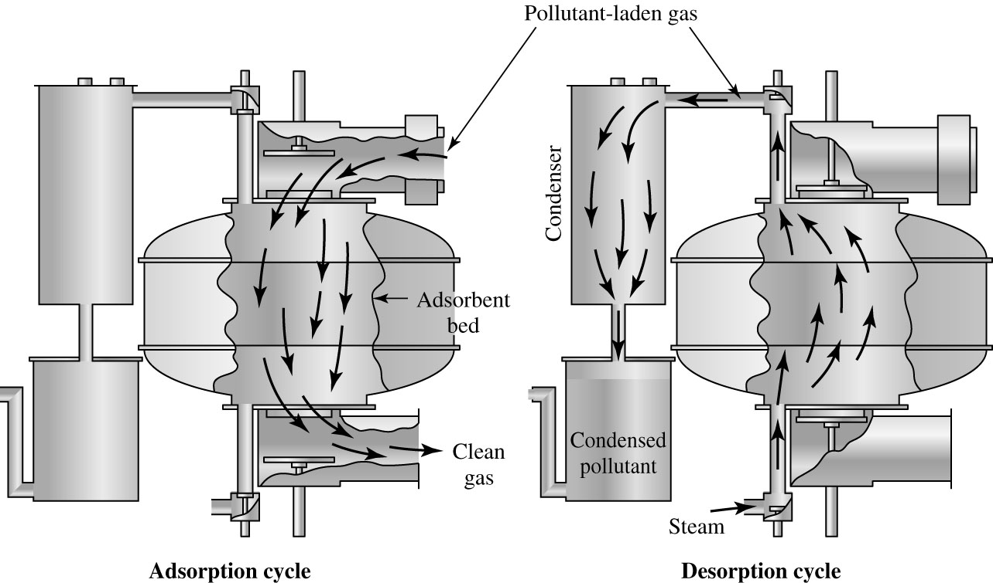
Gas & Vapor Treatment
Methods
Gas/vapor absorption system

Slide 37
Reference
Davis M. L. and Cornwell D. A., McGraw-Hill Co. (2013). Introduction to Environmental Engineering. 5th Ed.

